Slide 1

B.TECH PROJECT PHASE 1
FINAL INTERNAL REVIEW
SAINTGITS
COLLEGE OF ENGINEERING
(AUTONOMOUS)
LEARN . GROW . EXCEL

Slide 2
Embodied Semantic Asset Recall Robot
Offline Industrial Object Search, Recall, and Verification via Edge-Optimized Vision-Language Models
SAINTGITS
COLLEGE OF ENGINEERING
(AUTONOMOUS)
PROJECT AREA : Edge AI, Embedded Systems, Mobile Robotics
PRESENTED BY:
Sidharth Sajith
Nidhi N
Tharun Oommen Jacob
Jibin C Basil
SUPERVISOR:
Chinn Mohanan
Assistant Professor
Department of Electronics Engineering
LEARN . GROW . EXCEL

Slide 3

PROBLEM STATEMENT
In shared laboratory and workshop environments, tools, components and safety equipment move between many hands, a multimeter borrowed from the electronics bench appears days later on a mechanical shelf; safety goggles vanish before an inspection; a soldering iron changes benches without a record.
Traditional solutions fall short:
• CCTV records video but cannot answer spatial queries like "Where is the multimeter right now?"
• RFID/Barcode needs tagging every item and reader infrastructure — discipline that rarely survives a busy semester
• Manual inventory checks are infrequent, labour-intensive and error-prone
• Commercial inspection robots (e.g. Spot) cost upwards of $75,000, depend on cloud connectivity, and target fixed-infrastructure inspection — not movable-asset recall
Our answer: a fully offline, low-cost robot with persistent semantic memory-recall where assets were last seen, verify them visually, and when an object is moved, run probabilistic active search to find it efficiently.
LEARN . GROW . EXCEL

Slide 4
TOPIC IDENTIFICATION
• Combines Edge AI, Embedded Systems, and Mobile Robotics
• Relevant to industrial automation, lab/workshop management, and safety compliance
• Scope for simulation (Gazebo + ROS 2) now, real-world hardware deployment as funds land
• Persistent semantic memory → queryable spatial knowledge across reboots
• Probabilistic active search for moved objects using Bayesian belief over discrete zones
• Natural-language/visual interaction via a companion phone app (offline)
• Hybrid distributed compute: smartphone ARCore + local PC (RTX 4060) + ESP32 — no onboard Jetson, no cloud
• Smartphone ARCore replaces expensive LiDAR for visual-inertial odometry
• Two-phone design: sensing phone on the robot (data), interaction phone for the user (control + queries)
LEARN . GROW . EXCEL

Slide 5
OBJECTIVES
1. Build a reliable 2WD differential-drive mobile base with fused localisation (ARCore VIO + optional wheel odometry + EKF) achieving ≤0.1 m pose accuracy in a 5 m × 5 m room.
2. Develop a two-stage perception pipeline on the local PC: continuous open-vocabulary detection (YOLO-World) + event-triggered VLM verification (Florence-2/NanoLLaVA) at keyframes — benchmarked against Grounding-DINO on an RTX 4060.
3. Implement a persistent semantic scene graph (JSON-backed) storing per asset: unique ID, class, 3D position, timestamp, confidence, spatial relationships (on/inside/near), carrier associations — surviving power cycles.
4. Enable natural-language asset recall through the interaction phone app: query → parse intent → navigate to last-known location → visually verify → report with bounding box + on-screen confirmation.
LEARN . GROW . EXCEL

Slide 6
OBJECTIVES (Contd.)
5. Implement Bayesian active search for moved/missing objects: probability over discrete candidate zones; updates from history, semantic, carrier priors and detection-failure-aware updates — production module soma_brain/, unit-tested.
6. Demonstrate three scenarios in a real lab/workshop (internet disabled): stationary tool recall · moved-object search · safety compliance inspection.
7. Quantify against four baselines (random, nearest-zone, last-known-only, semantic-prior): success rate, time-to-find, path length, viewpoints visited, runtime (RAM, FPS, latency).
8. Two-phone human-robot interface: on-robot phone (soma-app: VIO + stream) + user's interaction phone (queries, memory cards, heatmap); ultrasonic e-stop for close-range safety.
LEARN . GROW . EXCEL

Slide 7
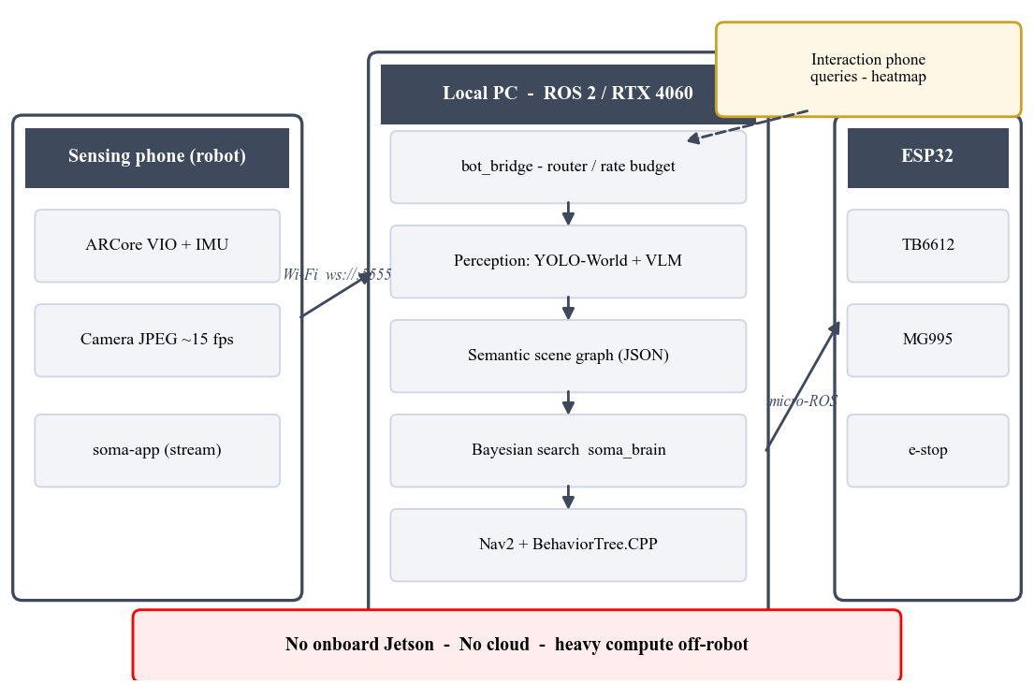
METHODOLOGY
Literature survey & problem formulation — semantic mapping, scene graphs, probabilistic search and edge AI studied (25+ papers); the offline asset-recall problem and research gap are defined. Done.
Hybrid architecture (locked with guide, 08-Sep-2026) — sensing phone → local PC (ROS 2, RTX 4060) → ESP32 (micro-ROS). No onboard Jetson, no cloud; the robot carries control and sensing only.
Phased plan — M2a: static pan-tilt bench rig now (demo, ≈₹4,600); M2b: mobile base later. Perception, memory, search and dashboard are identical in both phases — no throwaway work.
Hardware platform — hexagonal two-level chassis (CAD complete), 2WD + front castor, 65 mm wheels, phone on MG995 tilt sweep, TB6612FNG + ESP32, 3S LiPo.
Hybrid pipeline: sensing phone → ROS 2 PC → ESP32 (no Jetson, no cloud)
LEARN . GROW . EXCEL

Slide 8
METHODOLOGY (Contd.)
Perception (local PC) — benchmark YOLO-World vs Florence-2 vs Grounding-DINO (mAP/FPS/RAM) on a lab-object dataset → select the two-stage detect+verify pipeline.
Semantic memory & Bayesian search — scene-graph schema + JSON persistence; soma_brain/ production module (2D probability grid, conical sensor model, NBV planner) — 12 pytest invariants passing.
Navigation & executive — Gazebo simulation first, then real: EKF fuses VIO (+ optional wheel odom); Nav2 + BehaviorTree.CPP for recall → verify → search with failure handling.
Validation — sim → lab rosbags → real trials; metrics vs 4 baselines; demo with internet disabled.
LEARN . GROW . EXCEL

Slide 9
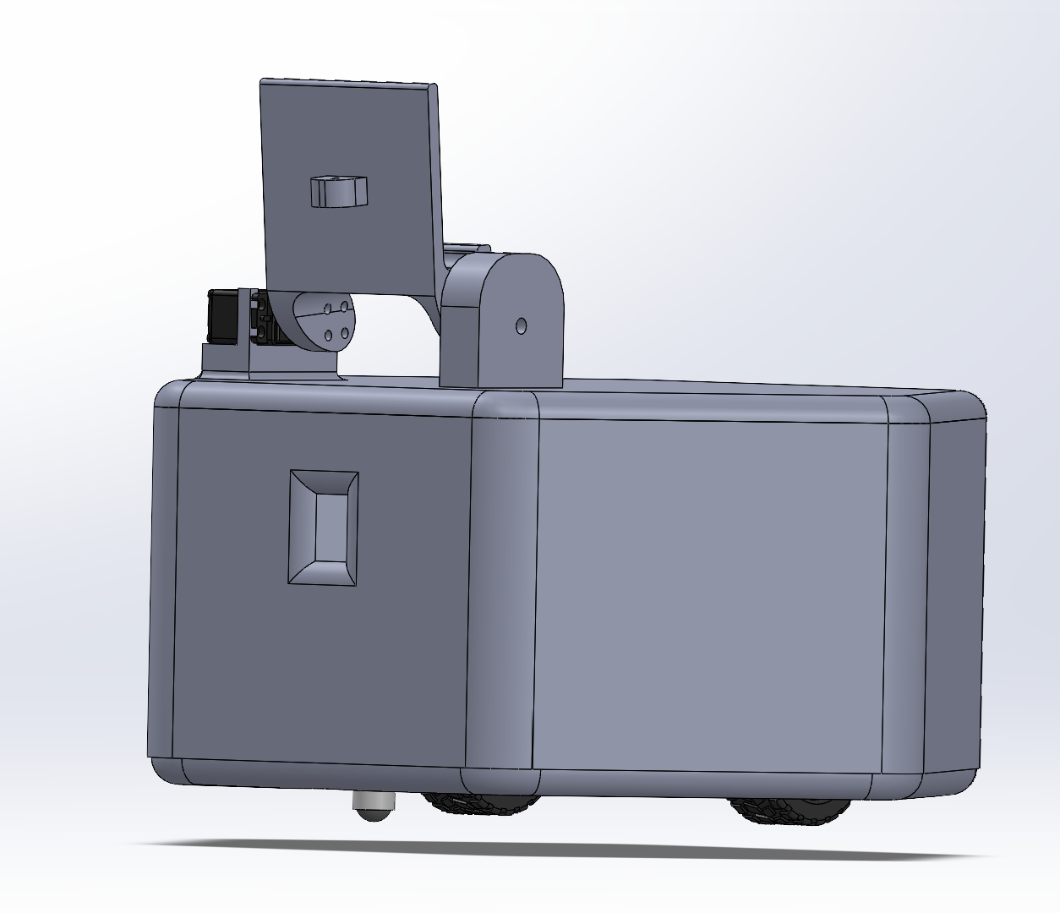
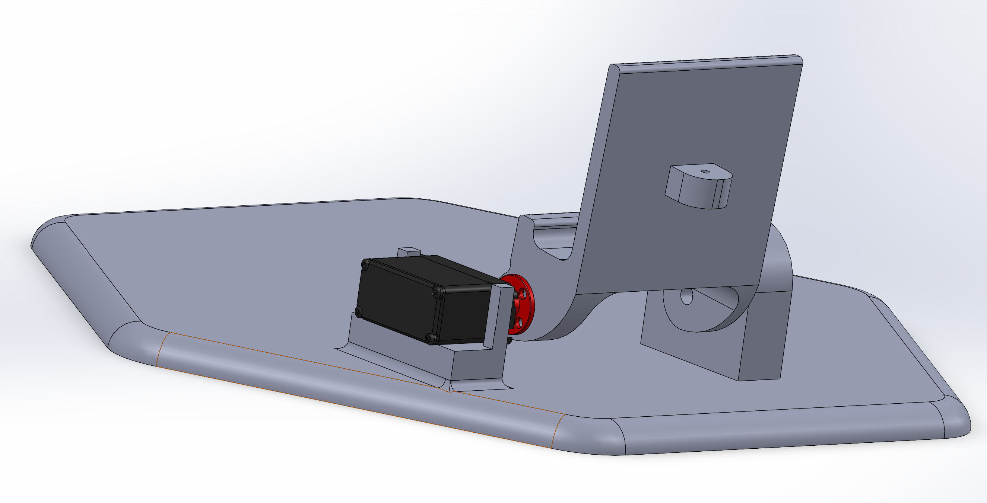
THE MODEL
MECHANICAL PLATFORM — SOLIDWORKS assembly complete: hexagonal two-level chassis, 2WD + front castor, 65 mm wheels; top deck: phone on MG995 tilt sweep; component deck: ESP32, TB6612FNG, buck, 3S LiPo.
VERIFIED BY ANALYSIS — 1.27× drive-torque margin at 3 kg and 6.9× servo margin (docs/mechanical/rationale.md).
SOFTWARE TWIN — assembly exported to assembled.sldasm + 6 renders + PDF report; soma_description URDF mirrors the CAD and loads in RViz.
CAD assembly — assembled.SLDASM
Phone holder + MG995 tilt (render)
LEARN . GROW . EXCEL

Slide 10
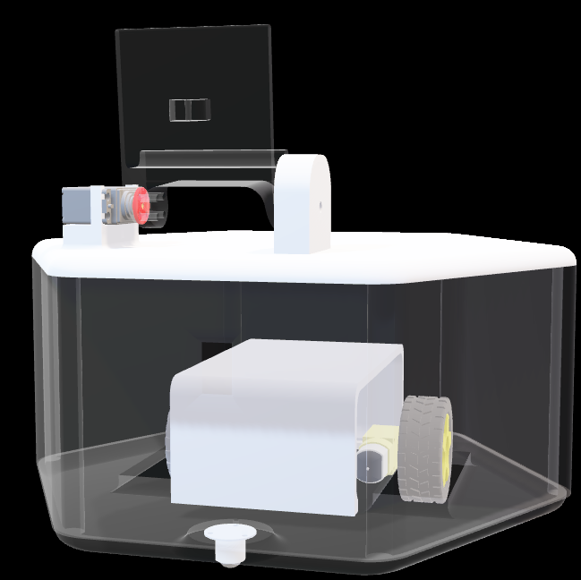
INTERACTIVE 3D MODEL
Live 3D — drag to rotate, scroll to zoom during the presentation. Source: docs/mechanical/assembled.glb (SolidWorks export)
LEARN . GROW . EXCEL

Slide 11
RESEARCH GAP
Existing research (from literature survey):
• Semantic mapping extensively studied for robot navigation (VLMaps, ConceptFusion)
• 3D scene graphs with open-vocabulary objects demonstrated (ConceptGraphs, DovSG, HOV-SG)
• Dynamic object tracking via carrier relationships proposed (OpenObject-NAV, DovSG)
• Probabilistic/active search with semantic priors validated (ZAVIS, SEEK, L3MVN)
• Simulation-based training widely used to reduce cost/risk
• Industrial inspection robots prove commercial value (AutoInspect, Spot, Simbe Tally)
• Edge-optimized models enable on-device VLM inference (YOLO-World, Florence-2, NanoLLaVA)
LEARN . GROW . EXCEL

Slide 12
RESEARCH GAP (Contd.)
Identified Gap:
No existing system integrates ALL FIVE of the following:
1. Persistent object-level semantic memory (survives power cycles, queryable across sessions)
2. Bayesian active search for moved/missing objects (belief updates with semantic priors + carrier relationships)
3. Fully offline operation on a sub-₹8,000 robot (phones student-owned)
4. Without LiDAR or depth cameras (smartphone ARCore only)
5. In a real shared lab/workshop environment (not simulation)
Specific gap: No work demonstrates a low-cost, fully offline, mobile semantic asset-recall system for small shared workspaces where objects are movable, untagged, and visually identified without cloud AI, RFID, or LiDAR.
LEARN . GROW . EXCEL

Slide 13
LITERATURE SURVEY
TITLE | ABOUT | REFERENCE
VLMaps | Constructs 3D semantic maps by fusing VLM features into a volumetric or point-based map representation. | Huang et al., ICRA 2023
ConceptGraphs | Builds open-vocabulary 3D scene graphs where nodes are object instances with CLIP embeddings and edges encode spatial/semantic relationships. | Gu et al., ICRA 2024
DovSG | Addresses long-term robotic operation by maintaining a dynamic 3D scene graph that incrementally updates as the environment changes. | Zhu et al., RA-L 2025
LEARN . GROW . EXCEL

Slide 14
LITERATURE SURVEY (Contd.)
TITLE | ABOUT | REFERENCE
SEEK | Proposes a semantic reasoning framework for object search that combines LLMs with scene graphs. | Ginting et al., RSS 2024
Open Scene Graphs | Introduces a persistent, open-vocabulary 3D scene graph as long-term semantic memory for navigation. | Loo et al., IJRR 2024
YOLO-World / Florence-2 | YOLO-World: Real-time open-vocabulary detection using vision-language pre-training; accepts text prompts at inference to detect arbitrary classes without retraining. | Cheng et al., CVPR 2024 / Xiao et al., 2023
LEARN . GROW . EXCEL

Slide 15

PROPOSED FOCUS & CONTRIBUTIONS
Focus: an offline semantic asset-recall system on a low-cost mobile robot, evaluated in a real laboratory, with persistent memory, probabilistic moved-object search and phone-based interaction — fully offline (hybrid PC, no cloud, no LiDAR) on a ≈₹7,400 robot.
PROJECT CONTRIBUTIONS
1. Ultra-low-cost offline architecture — complete robot ≈₹7,400 (rig ₹4,600 + base ₹2,790) + two student-owned phones; ARCore VIO replaces LiDAR; compute on the lab PC.
2. Persistent semantic scene graph — JSON-backed object-level memory (identity, 3D location, timestamp, confidence, relations, carriers), survives reboots.
3. Benchmark-driven edge perception — YOLO-World vs Florence-2 vs Grounding-DINO on real lab data → two-stage detect+verify pipeline sized for the RTX 4060.
4. Bayesian active search engine — discrete-zone belief with history/semantic/carrier priors, failure-aware updates, explainable log — shipped as tested module soma_brain/ (12/12 tests).
5. Two-phone human-robot interface — sensing phone on the robot + interaction phone app (queries, memory cards, heatmap); no cloud, no extra display/mic/speaker hardware.
6. End-to-end real-world validation — three demo scenarios, quantitative comparison vs 4 baselines, internet disabled.
Future scope (not committed): optional cloud offload for heavier VLMs, LiDAR/encoder upgrades, voice interaction.

Slide 16
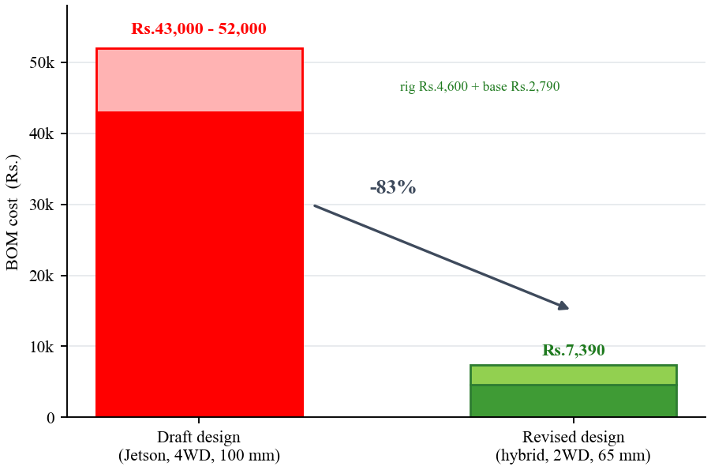
PROJECT EVOLUTION
WHERE WE STARTED (Zeroth + First Review, Aug–Sep 2026)
Fully autonomous 4WD bot, onboard Jetson Orin Nano, 100 mm wheels, BTS7960 ×2, 4S 5000 mAh LiPo, 7″ touchscreen + 4-mic array — draft BOM ₹43,000–52,000.
WHAT WE REMOVED (and why)
Jetson → hybrid local PC (−₹40k, guide-approved 08-Sep) · 4WD → 2WD + castor · BTS7960 → TB6612FNG · 4S → 3S · 100 mm → 65 mm (torque maths) · touchscreen/mic/speaker → interaction-phone app
WHERE WE ARE NOW (05-Oct-2026)
M1 DONE — two repos, V1 APK, WebSocket→ROS 2 bridge, soma_brain 12/12 tests · M2 IN PROGRESS — full CAD + renders + report, URDF/RViz, BOM locked, roadmap locked for November
NEXT — Gazebo → EKF on rosbags → perception benchmark → BT → dashboard (M3–M7)
Bill of materials: draft vs revised (₹)
LEARN . GROW . EXCEL

Slide 17
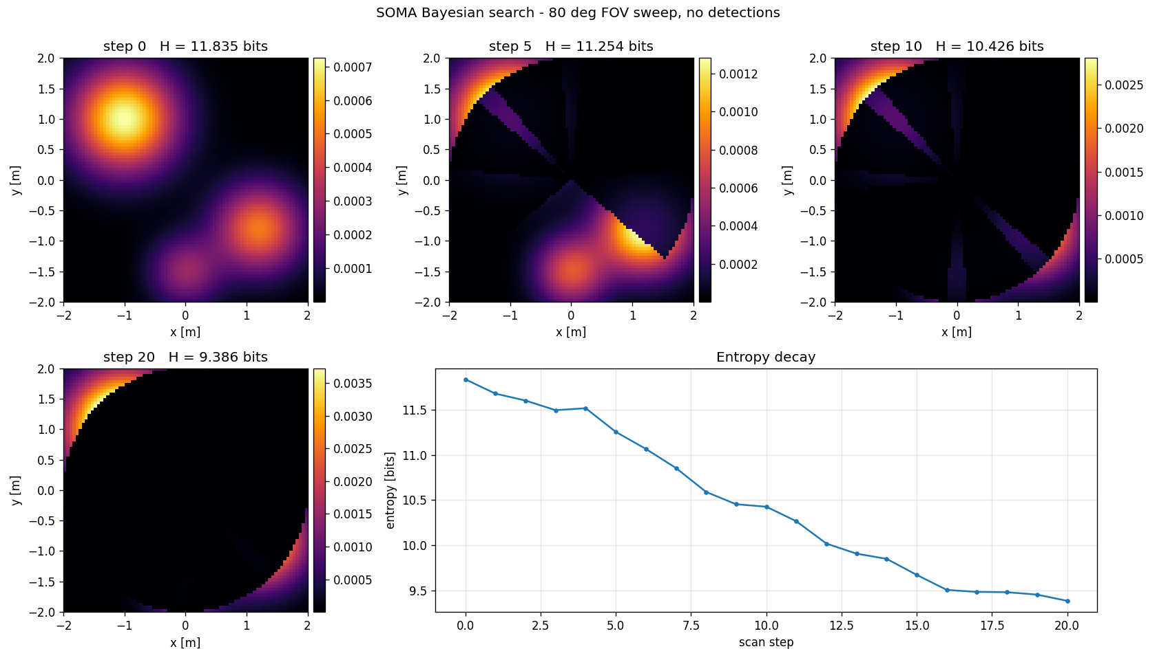
PROGRESS & RESULTS
SOFTWARE
soma_brain/ production module (Bayesian grid, sensor model, NBV planner) — 12/12 pytest green (0.83 s) · SOMA-Link-V1.apk shipped · WebSocket→ROS 2 bridge · URDF loaded in RViz
MECHANICAL
full CAD assembly + 6 renders + assembled.glb + PDF report · drive/servo sizing verified (1.27× / 6.9× margins)
PLANNING & FEASIBILITY
BOM revised ₹43,000 → ₹4,600 + ₹2,790 · roadmap + approach decision recorded · project journal (docs/archive/)
Bayesian search simulation — probability heatmap + entropy decay (soma_brain)
12 / 12 pytest invariants green — 0.83 s
LEARN . GROW . EXCEL

Slide 18
ROAD MAP
Not completed
Partially completed
Fully completed
 | WEEK 1 | WEEK 2 | WEEK 3 | WEEK 4 | WEEK 5 | WEEK 6 | WEEK 7 | WEEK 8 | WEEK 9 | WEEK 10 | WEEK 11 | WEEK 12
M1 — Repo & env lockdown
M2 — Robot in sim + bench rig
M3 — Real phone pipeline
M4 — Perception benchmark
M5 — Intelligence (Bayesian + BT)
M6 — Dashboard
M7 — End-sem package
▲ NOW
Locked for End-Sem Review, November 2026 · hardware funds land Oct–Nov 2026 · M1 done, M2 in progress
LEARN . GROW . EXCEL

Slide 19
RESOURCE REQUIREMENTS
SOFTWARE REQUIREMENTS
• Ubuntu 22.04 + ROS 2 Humble (dev machine: RTX 4060 / Ryzen 7 dual-boot)
• Gazebo + RViz2 — simulation, TF, bring-up
• Python 3.10+ / PyTorch / ONNX — perception prototyping on the PC
• YOLO-World · Florence-2 · Grounding-DINO — M4 benchmark candidates
• BehaviorTree.CPP + Groot2 — task executive
• OctoMap — 3D occupancy mapping (M3)
• React + roslibjs / foxglove — dashboard (M6)
• Android Studio + ARCore SDK — soma-app (sensing) + interaction app
• micro-ROS (ESP-IDF) — ESP32 firmware
• pytest — soma_brain invariant suite · Git/GitHub — version control
LEARN . GROW . EXCEL

Slide 20
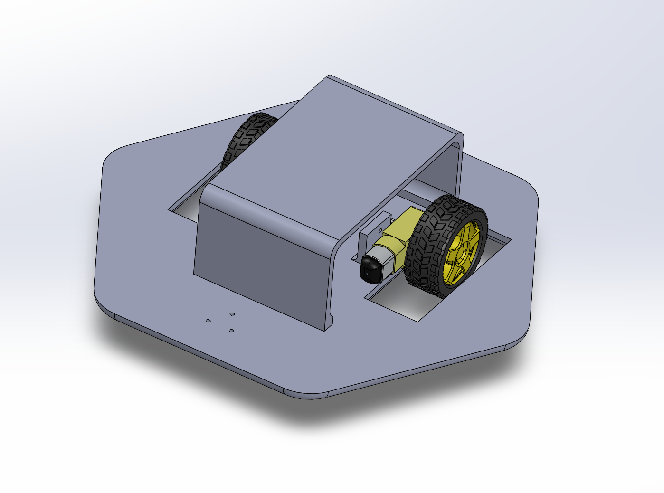
RESOURCE REQUIREMENTS
HARDWARE REQUIREMENTS & BUDGET
COMPUTE & SENSING — 2× ARCore phones (student-owned, ₹0) · ESP32 DevKit ₹420 · VL53L0X ToF ₹290 · HC-SR04 ×3 ₹165
MOBILITY & POWER — geared DC motors ×2 (OPEN, ≈₹116–166) · 65 mm wheels + castor ₹119 · TB6612FNG ₹131 · MG995 tilt ₹400 · 3S 1000 mAh LiPo ₹995 + balance charger ₹333 · buck 5 V/5 A ₹114
STRUCTURE — hexagonal two-level chassis per CAD (3D print / acrylic — TBD) · printed phone holder + MG995 horn
BUDGET — Phase-1 bench rig ≈₹4,600 (orderable now) · Phase-2 mobile base ≈₹3,100 + chassis/wiring TBD → ≈₹40,000 cheaper than the draft
Optional adds: encoders +₹1,000 · RPLIDAR +₹9,000
Component deck per CAD (render)
LEARN . GROW . EXCEL

Slide 21
REFERENCES
[1] C. Huang, O. Mees, A. Zeng, and W. Burgard, "Visual Language Maps for Robot Navigation," Proc. IEEE ICRA, London, UK, pp. 10608-10615, 2023.
[2] K. Jatavallabhula et al., "CLIP-Fields: Weakly Supervised Semantic Fields for Robotic Memory," Proc. RSS, 2022.
[3] K. Jatavallabhula et al., "ConceptFusion: Open-Set Multimodal 3D Mapping," Proc. RSS, 2023.
[4] Q. Gu et al., "ConceptGraphs: Open-Vocabulary 3D Scene Graphs for Perception and Planning," Proc. IEEE ICRA, 2024.
[5] Z. Yan et al., "Dynamic Open-Vocabulary 3D Scene Graphs for Long-Term Language-Guided Mobile Manipulation (DovSG)," IEEE RA-L, 2025.
[6] J. Loo et al., "Open Scene Graphs for Open-World Object-Goal Navigation," 2024.
[7] X. Li et al., "OpenObject-NAV: Open-Vocabulary Object-Oriented Navigation Using Dynamic Carrier-Relationship Scene Graphs," arXiv:2409.18743, 2024.
[8] X. Li et al., "OpenIN: Open-Vocabulary Instance-Oriented Navigation in Dynamic Environments," arXiv:2501.04279, 2025.
[9] M. Karnan et al., "ZAVIS: Zero-Shot Active Visual Search," arXiv:2209.08803, 2022.
[10] M. Ginting et al., "SEEK: Semantic Reasoning for Object Goal Navigation in Real-World Inspection Tasks," Proc. RSS, 2024.
LEARN . GROW . EXCEL

Slide 22
THANK YOU
LEARN . GROW . EXCEL

